Slide 1


Cloud computing security
INGI2347: COMPUTER SYSTEM SECURITY (Spring 2014)
Marco Canini
Lecture slides adapted from Upenn NETS212 by Andreas Haeberlen Reproduced with permission
Notes:
Image source: http://www.ciphercloud.com/wp-content/uploads/2013/10/Cloud_Computing_Security_Threats.jpg

Slide 2
Plan for today
Lecture 12
Cloud computing
The need for scaling from PCs to data centers
What is cloud computing?
Virtualization: How clouds work “under the hood”
Security challenges of cloud computing
Software-defined networking (SDN)
The need for SDN
OpenFlow
NEXT

Slide 3
How many users and objects?
Flickr has >6 billion photos
Facebook has 1.15 billion active users
Google is serving >1.2 billion queries/day on more than 27 billion items
>2 billion videos/day watched on YouTube

Slide 4
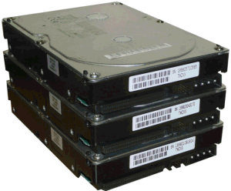
How much data?
Modern applications use massive data:
Rendering 'Avatar' movie required >1 petabyte of storage
eBay has >6.5 petabytes of user data
CERN's LHC will produce about 15 petabytes of data per year
In 2008, Google processed 20 petabytes per day
German Climate computing center dimensioned for 60 petabytes of climate data
Google now designing for 1 exabyte of storage
NSA Utah Data Center is said to have 5 zettabyte (!)
How much is a zettabyte?
1,000,000,000,000,000,000,000 bytes
A stack of 1TB hard disks that is 25,400 km high
25,400 km

Slide 5
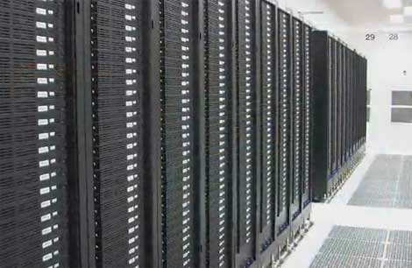
How much computation?
No single computer can process that much data
Need many computers!
How many computers do modern services need?
Facebook is thought to have more than 60,000 servers
Akamai has 95,000 servers in 71 countries
Intel has ~100,000 servers in 97 data centers
Microsoft reportedly had at least 200,000 servers in 2008
Google is thought to have more than 1 million servers, is planning for 10 million (according to Jeff Dean)

Slide 6
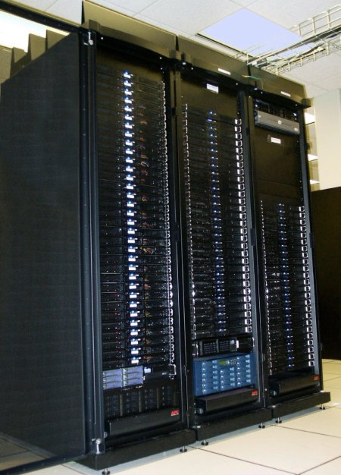
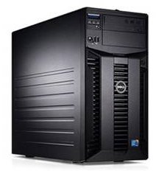
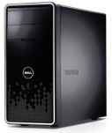
Scaling up
PC
Server
Cluster
What if one computer is not enough?
Buy a bigger (server-class) computer
What if the biggest computer is not enough?
Buy many computers

Slide 7
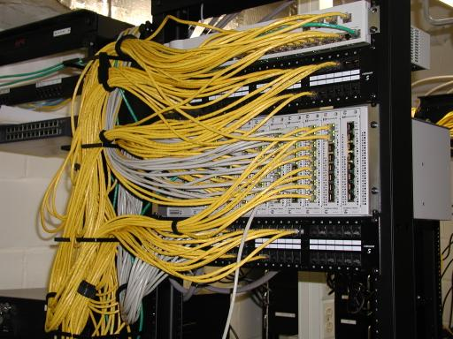
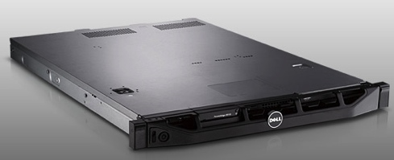
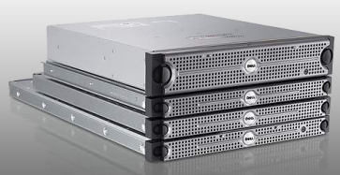
Clusters
Network switch (connects nodes with each other and with other racks)
Rack
Many nodes/blades (often identical)
Storage device(s)
Characteristics of a cluster:
Many similar machines, close interconnection (same room?)
Often special, standardized hardware (racks, blades)
Usually owned and used by a single organization

Slide 8
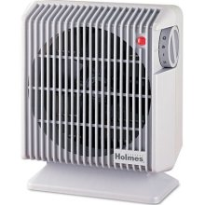
Power and cooling
Clusters need lots of power
Example: 140 Watts per server
Rack with 32 servers: 4.5kW (needs special power supply!)
Most of this power is converted into heat
Large clusters need massive cooling
4.5kW is about 3 space heaters
And that's just one rack!

Slide 9
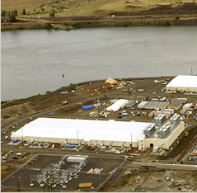
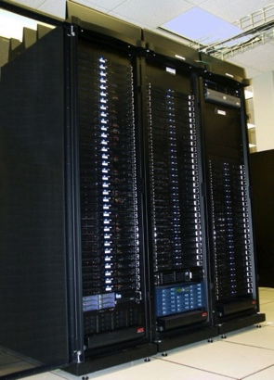
Scaling up
PC
Server
Cluster
Data center
What if your cluster is too big (hot, power hungry) to fit into your office building?
Build a separate building for the cluster
Building can have lots of cooling and power
Result: Data center

Slide 10
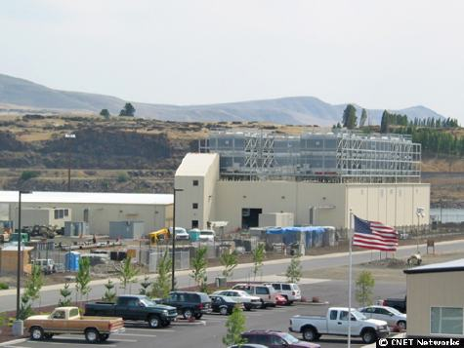
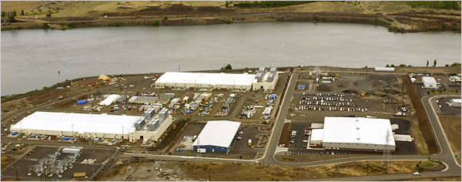
What does a data center look like?
Cooling plant
Data centers (size of a football field)
Google data center in The Dalles, Oregon
A warehouse-sized computer
A single data center can easily contain 10,000 racks with 100 cores in each rack (1,000,000 cores total)

Slide 11
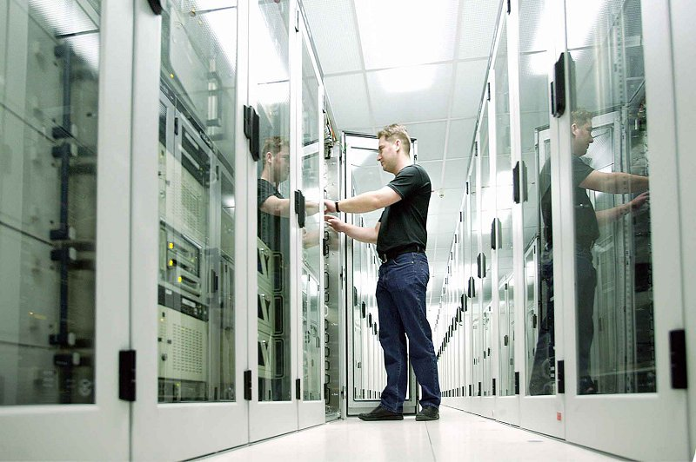
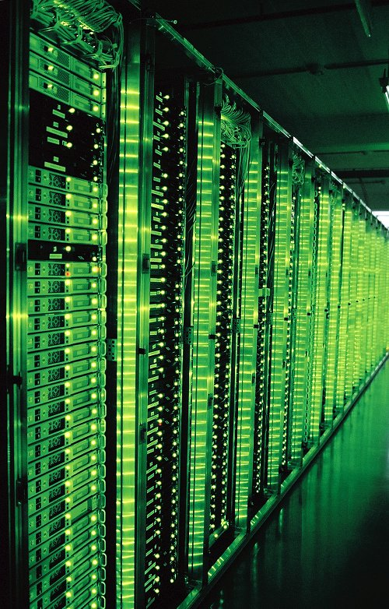
What’s in a data center?
Source: 1&1
Hundreds or thousands of racks

Slide 12
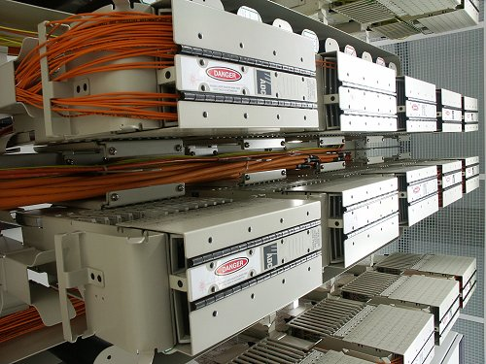
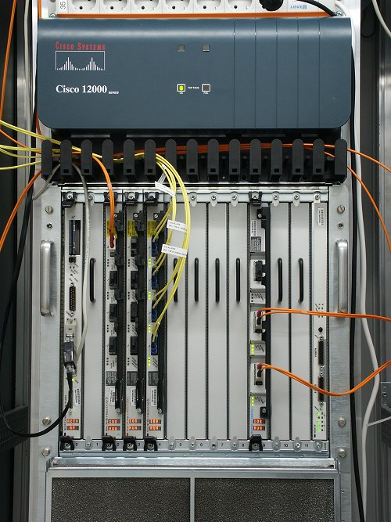
What’s in a data center?
Source: 1&1
Massive networking

Slide 13
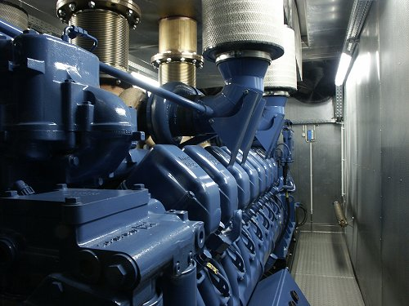
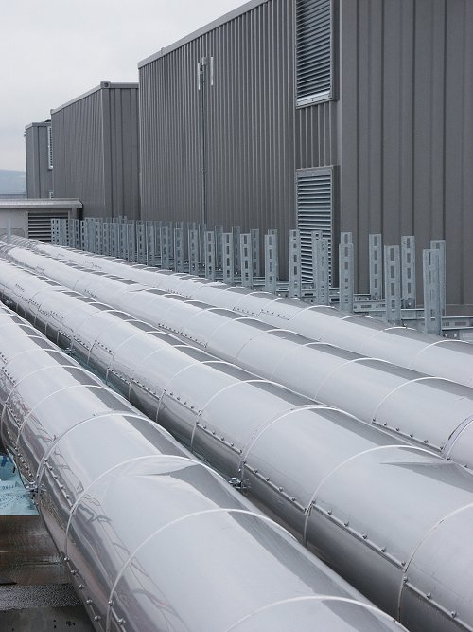
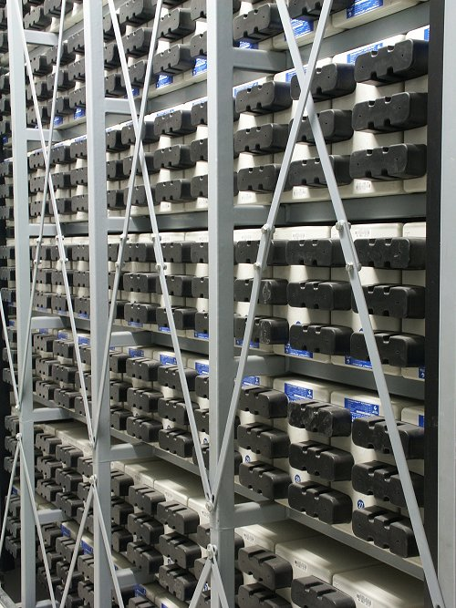
What’s in a data center?
Source: 1&1
Emergency power supplies

Slide 14
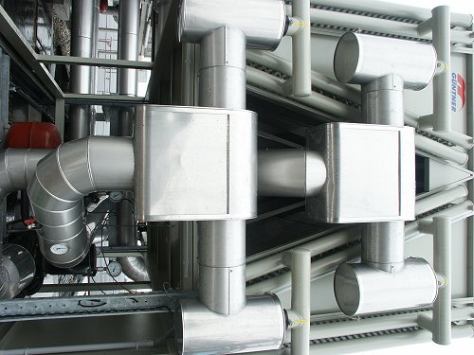
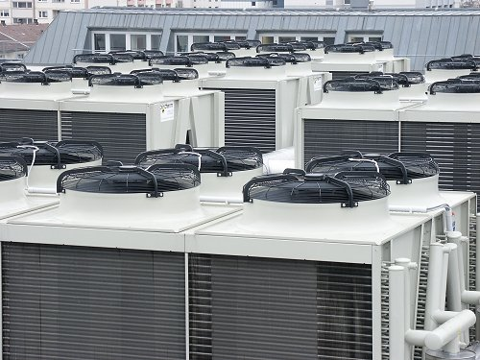
What’s in a data center?
Source: 1&1
Massive cooling

Slide 15
Energy matters!
Company | Servers | Electricity | Cost
eBay | 16K | ~0.6*10⁵ MWh | ~$3.7M/yr
Akamai | 40K | ~1.7*10⁵ MWh | ~$10M/yr
Rackspace | 50K | ~2*10⁵ MWh | ~$12M/yr
Microsoft | >200K | >6*10⁵ MWh | >$36M/yr
Google | >500K | >6.3*10⁵ MWh | >$38M/yr
USA (2006)
10.9M
610*10⁵ MWh
$4.5B/yr
Source: Qureshi et al., SIGCOMM 2009
Data centers consume a lot of energy
Makes sense to build them near sources of cheap electricity
Example: Price per KWh is 3.6ct in Idaho (near hydroelectric power), 10ct in California (long distance transmission), 18ct in Hawaii (must ship fuel)
Most of this is converted into heat → Cooling is a big issue!

Slide 16

Scaling up
PC
Server
Cluster
Data center
Network of data centers
What if even a data center is not big enough?
Build additional data centers
Where? How many?

Slide 17
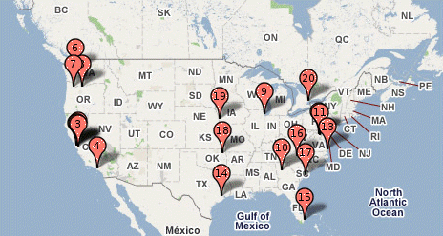
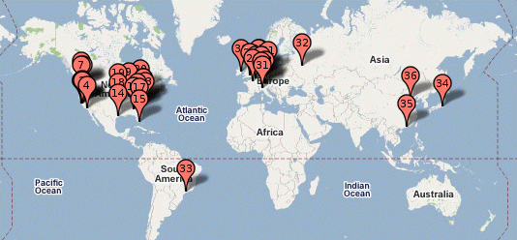
Global distribution
Data centers are often globally distributed
Example above: Google data center locations (inferred)
Why?
Need to be close to users (physics!)
Cheaper resources
Protection against failures

Slide 18
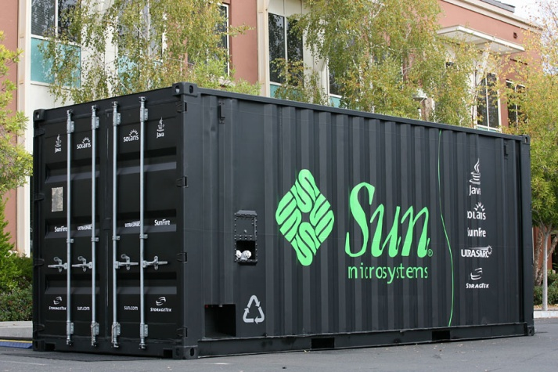
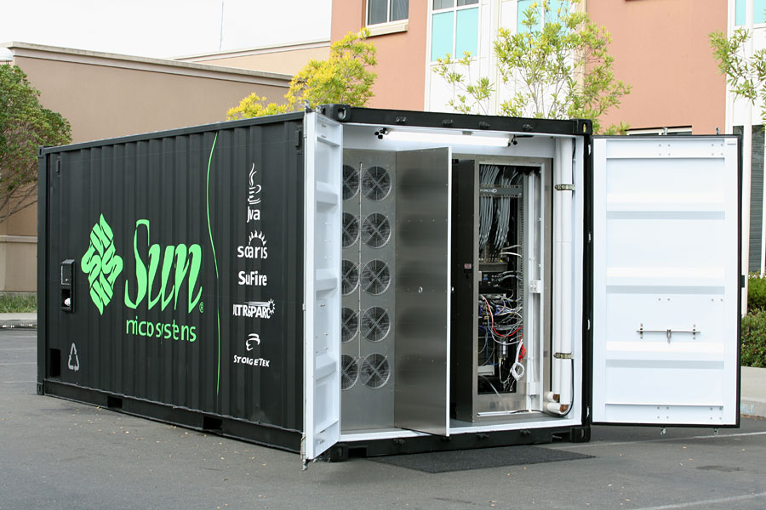
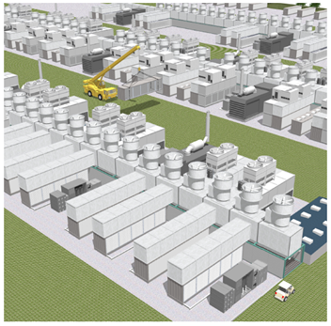
Trend: Modular data center
Need more capacity? Just deploy another container!

Slide 19
What is cloud computing?

Slide 20
What is cloud computing?
According to NIST:
Essential characteristics:
On-demand self service
Broad network access
Resource pooling
Rapid elasticity
Measured service
Cloud computing is a model for enabling convenient, on-demand network access to a shared pool of configurable computing resources (e.g., networks, servers, storage, applications, and services) that can be rapidly provisioned and released with minimal management effort or service provider interaction.

Slide 21

Why is this a good thing?
Economies of scale
Cheaper to run one big data center than many small ones
Statistical multiplexing
High utilization!
No up-front commitment
No investment in data center; pay-as-you-go model
Scalability
Thousands of computers available on demand; add more within seconds

Slide 22
What kinds of clouds exist today?
Three types commonly distinguished:
Software as a service (SaaS)
Platform as a service (PaaS)
Infrastructure as a service (IaaS)
Other xaaS types exist, but are less common
Desktop, Backend, Communication, Network, Monitoring, ...

Slide 23




Software as a Service (SaaS)
User
Application
Middleware
Hardware
Cloud provider
Cloud provides an entire application
Word processor, spreadsheet, CRM software, calendar...
Customer pays cloud provider
Example: Google Apps, Salesforce.com

Slide 24



Platform as a Service (PaaS)
Service provider
User
Application
Middleware
Hardware
Cloud provider
Cloud provides middleware/infrastructure
Customer pays service provider for the service; service provider pays the cloud for the infrastructure
Example: Windows Azure, Google App Engine

Slide 25

Infrastructure as a Service (IaaS)
Service provider
User
Application
Middleware
Hardware
Cloud provider
Cloud provides raw computing resources
Virtual machine, blade server, hard disk, ...
Customer pays service provider for the service; service provider pays the cloud for the resources
Examples: Amazon Web Services, Rackspace Cloud, GoGrid

Slide 26




Private/hybrid/community clouds
Company A
Company B
Public
Community
Private
Who can become a customer of the cloud?
Public cloud: Commercial service; open to (almost) anyone. Example: Amazon AWS, Microsoft Azure, Google App Engine
Community cloud: Shared by several similar organizations. Example: Google’s “Gov Cloud”
Private cloud: Shared within a single organization. Example: Internal datacenter of a large company.

Slide 27
Virtualization: How clouds work “under the hood”

Slide 28

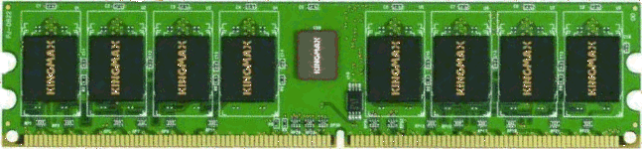

What is virtualization?
Bob
Charlie
Alice
Physical machine
Daniel
Suppose Alice has a machine with 4 CPUs and 8 GB of memory, and three customers:
Bob wants a machine with 1 CPU and 3GB of memory
Charlie wants 2 CPUs and 1GB of memory
Daniel wants 1 CPU and 4GB of memory
What should Alice do?

Slide 29


What is virtualization?
Bob
Virtual machine monitor (VMM)
Charlie
Alice
Physical machine
Virtual machines
Daniel
Alice can sell each customer a virtual machine (VM) with the requested resources
From each customer’s perspective, it appears as if they had a physical machine all by themselves (isolation)

Slide 30
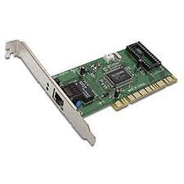
How does it work?
App
VM 1
VM 2
VM | Virt | Phys
1 | 0-99 | 0-99
1 | 299-399 | 100-199
2 | 0-99 | 300-399
2 | 200-299 | 500-599
2 | 600-699 | 400-499
App
App
OS 1
OS 2
VMM
Translation table
Physical machine
Resources (CPU, memory, ...) are virtualized
VMM ("Hypervisor") has translation tables that map requests for virtual resources to physical resources
Example: VM 1 accesses memory cell #323; VMM maps this to memory cell #123.
For which resources does this (not) work?
How do VMMs differ from OS kernels?

Slide 31

Benefit: Migration
Emil
Bob
Virtual machine monitor
Alice
Charlie
Virtual machines
Daniel
Physical machines
What if the machine needs to be shut down?
e.g., for maintenance, consolidation, ...
Alice can migrate the VMs to different physical machines without any customers noticing

Slide 32
Benefit: Time sharing
Emil
Bob
Virtual machine monitor
Charlie
Alice
Physical machine
Virtual machines
Daniel
What if Alice gets another customer?
Multiple VMs can time-share the existing resources
Result: Alice has more virtual CPUs and virtual memory than physical resources (but not all can be active at the same time)

Slide 33




Benefit and challenge: Isolation
Emil
Bob
VMM
Charlie
Alice
Physical machine
Virtual machines
Daniel
Good: Emil can’t access Charlie’s data
Bad: What if the load suddenly increases?
Example: Emil’s VM shares CPUs with Charlie’s VM, and Charlie suddenly starts a large compute job
Emil’s performance may decrease as a result
VMM can move Emil’s VM to a different CPU, or migrate it to a different machine

Slide 34
Security challenges of cloud computing

Slide 35
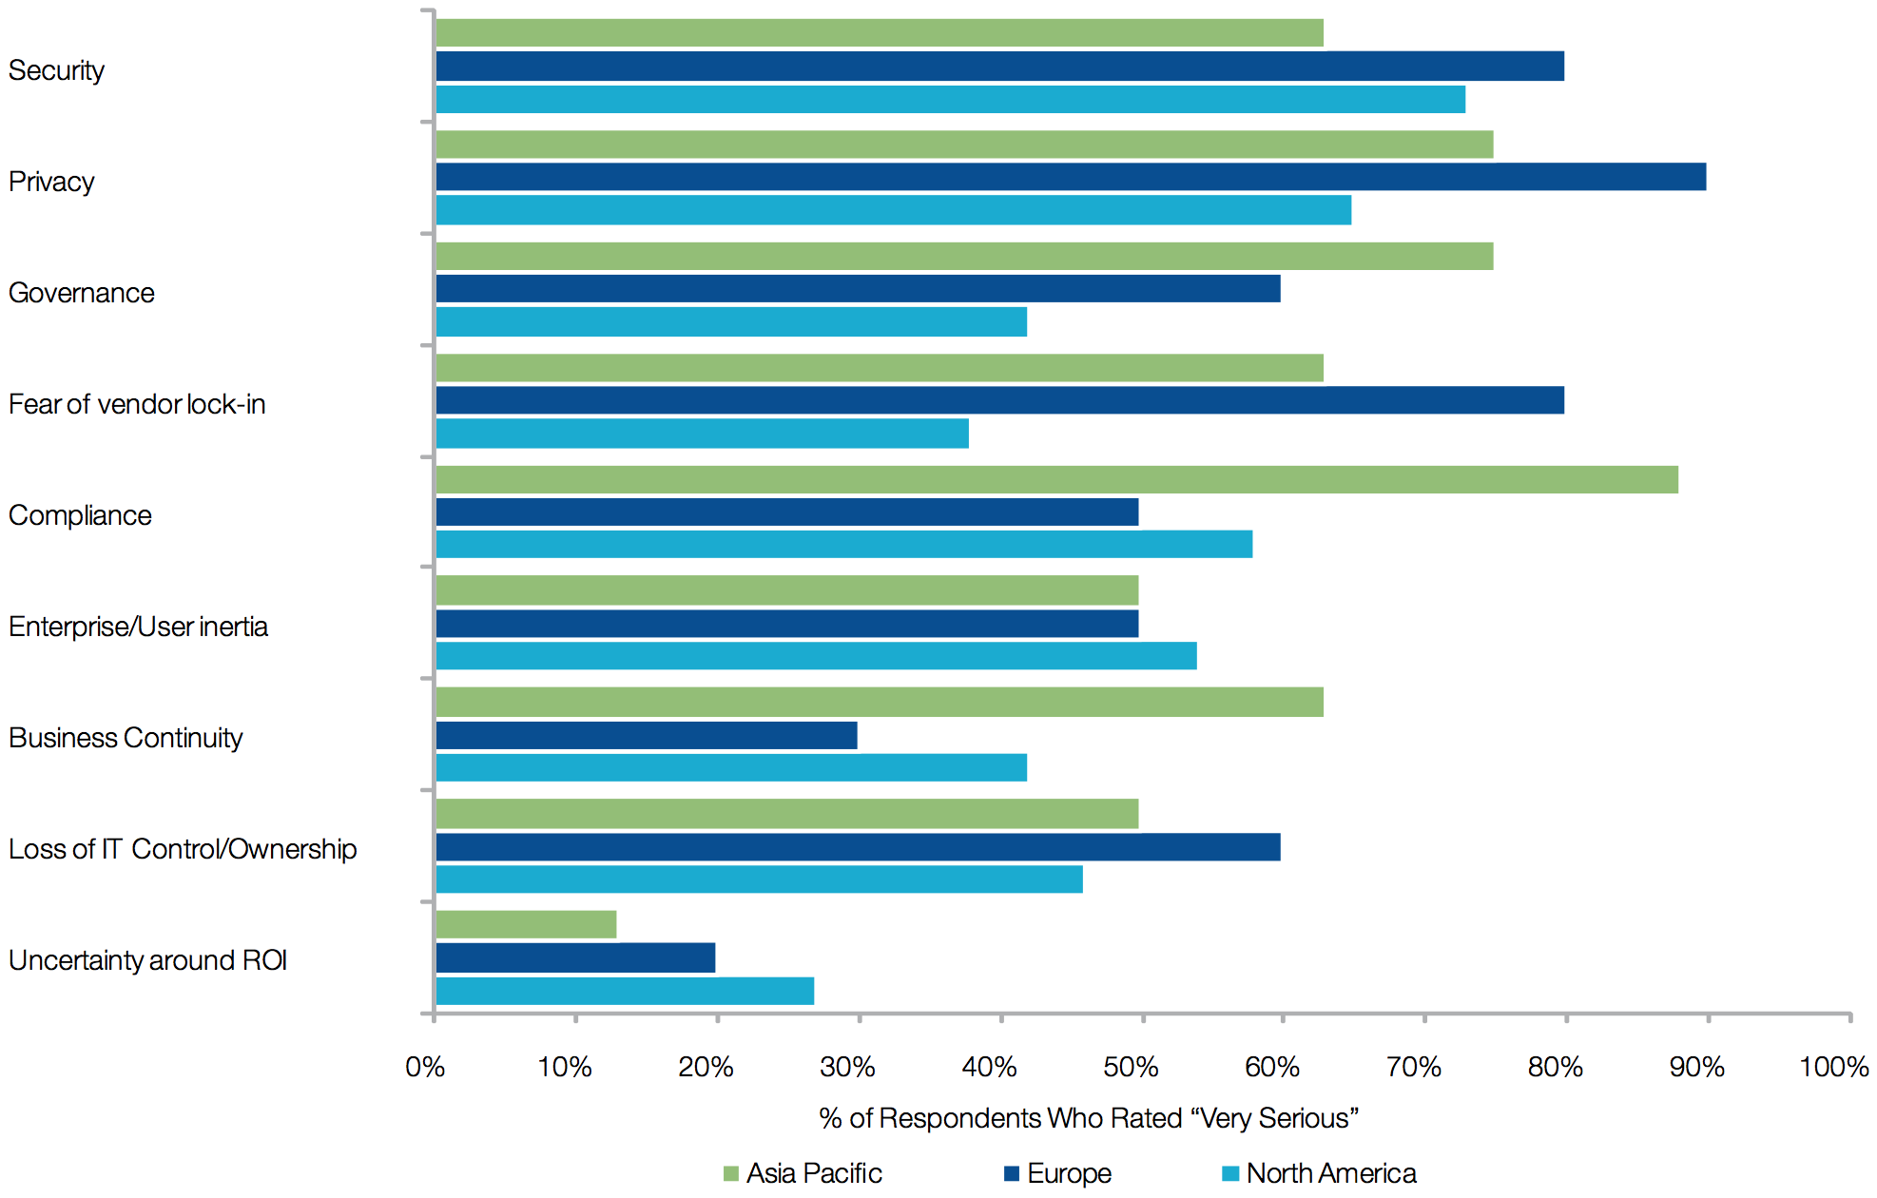
Survey: impediments to adoption
Source: Cloud Computing Survey 2009, World Economic Forum

Slide 36
Security challenges
Traditional threats with cloud-specific twists
Impact amplified by vast amount of available resources
Must secure the infrastructure
Authentication & authorization
Protect against DDoS, phishing, SQL injections, cross-site scripting, etc.
VMM vulnerabilities
New attack channels for malicious users
Starvation of resources
VM side-channel attacks by rouge VM
Buffer overflow attacks
Identify path followed by attacker is much more difficult

Slide 37
Security challenges
Data confidentiality and auditability
How do I make sure that the cloud doesn’t leak my confidential data?
Can I comply with regulations? E.g., will the stored data remain in EU?
Availability
What happens to my business if there is an outage in the cloud?
Data lock-in
How do I move my data from one cloud to another?
Service | Duration | Date
S3 | 6-8 hrs | 7/20/08
AppEngine | 5 hrs | 6/17/08
Gmail | 1.5 hrs | 8/11/08
Azure | 22 hrs | 3/13/09
Intuit | 36 hrs | 6/16/10
EBS | >3 days | 4/21/11
ECC | ~2 hrs | 6/30/12
Some recent cloud outages

Slide 38
Security challenges
Third-party control
Lack of transparency and limited user control
How can we trust resources? What if cloud provider subcontracts resources?
Abuse of cloud
APIs are not fully secure
Malicious insiders (employees of cloud provider)
Data loss and leakage

Slide 39
Software-Defined Networking (SDN)

Slide 40
Classical network architecture
Distributed control plane
Distributed protocols compute routing state
OSPF, IS-IS, BGP, etc.
Feature
Feature
Specialized Control Plane
Feature
Feature
Specialized Packet Forwarding Hardware
Specialized Control Plane
Feature
Feature
Specialized Packet Forwarding Hardware
Specialized Control Plane
Feature
Feature
Specialized Packet Forwarding Hardware
Specialized Control Plane
Feature
Feature
Specialized Packet Forwarding Hardware
Specialized Control Plane
Specialized Packet Forwarding Hardware

Slide 41
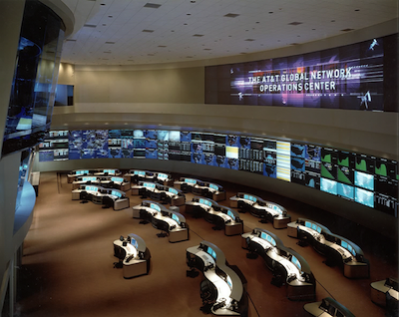
Networks are Hard to Manage
New requirements led to great complexity
Security, network virtualization, VM migration, perf. isolation, …
Kept working by “Masters of Complexity”
When things don’t work?
Only limited tools:
ping, traceroute, tcpdump, SNMP, NetFlow

Slide 42
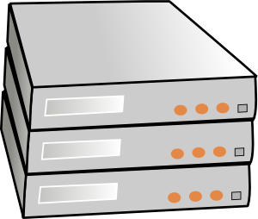
Separation of control and data planes
Feature
Feature
Network OS
Feature
Feature
Specialized Control Plane
Feature
Feature
Specialized Packet Forwarding Hardware
Specialized Control Plane
Feature
Feature
Specialized Packet Forwarding Hardware
Specialized Control Plane
Feature
Feature
Specialized Packet Forwarding Hardware
Specialized Control Plane
Feature
Feature
Specialized Packet Forwarding Hardware
Specialized Control Plane
Specialized Packet Forwarding Hardware

Slide 43
Software Defined Networking (SDN)
Feature
Feature
Constructs a logical map of the network
Global Network View
Network OS
Open vendor-agnostic protocol
Packet
Forwarding
Packet
Forwarding
OpenFlow
Packet
Forwarding
Packet
Forwarding
Simple packet forwarding hardware
Packet
Forwarding

Slide 44
Software Defined Networking (SDN)
Control
Programs
Control
Programs
Control
Programs
Abstract Network View
Network Virtualization
Constructs a logical map of the network
Global Network View
Network OS
Open vendor-agnostic protocol
Packet
Forwarding
Packet
Forwarding
OpenFlow
Packet
Forwarding
Packet
Forwarding
Simple packet forwarding hardware
Packet
Forwarding

Slide 45
Software Defined Networking (SDN)
firewall.c
…
if( pkt->tcp->dport == 22)
dropPacket(pkt);
…
Control
Programs
Control
Programs
Control
Programs
Abstract Network View
Network Virtualization
Global Network View
Network OS
<Match, Action>
<Match, Action>
<Match, Action>
<Match, Action>
<Match, Action>
…
…
<Match, Action>
<Match, Action>
<Match, Action>
<Match, Action>
<Match, Action>
…
…
Packet
Forwarding
<Match, Action>
<Match, Action>
<Match, Action>
<Match, Action>
<Match, Action>
…
…
<Match, Action>
<Match, Action>
<Match, Action>
<Match, Action>
<Match, Action>
…
…
Packet
Forwarding
<Match, Action>
<Match, Action>
<Match, Action>
<Match, Action>
<Match, Action>
…
…
Packet
Forwarding
Packet
Forwarding
Packet
Forwarding

Slide 46
What problem does SDN solve?
Great tool to enable innovation in network control
Platform to help solve longstanding problems in managing networks and deploying new functionality

Slide 47
SDN applications
Network management
Enterprise access, middleboxes waypointing
Monitoring and measurement
Network virtualization
User mobility and VM migration
Server load balancing
Traffic engineering
Energy efficiency, high WAN utilization
Exposing an API to host applications

Slide 48
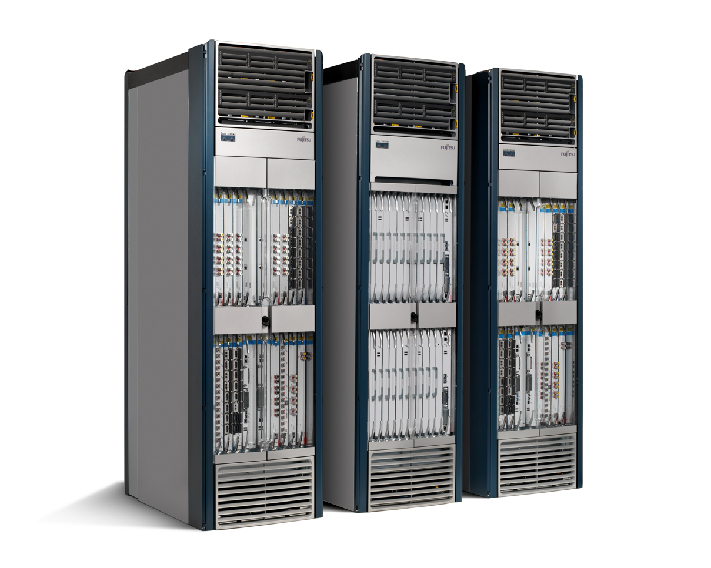
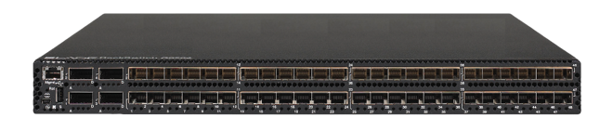
Timing matters
App
App
App
App
App
App
App
App
App
App
App
Specialized
Features
Open Interface
Control
Plane
Control
Plane
Control
Plane
or
or
Specialized
Control
Plane
Open Interface
Specialized
Hardware
Merchant
Switching Chips
Vertically integrated
Closed, proprietary
Slow innovation
Horizontal
Open interfaces
Rapid innovation

Slide 49
Where SDN will be deployed
Multi-tenant “virtualized” data centers
Public and private clouds
WANs
Google WAN; eventually, public WANs
Enterprise networks
Greater control, fewer middleboxes
IXP networks
More flexible peering policies

Slide 50
Where SDN will be deployed (2)
5. Home networks
Outsourced management
6. Cellular Networks
Separation of service from physical infrastructure
7. Research and Education Networks
National backbones
College campus networks (@ UCL too)

Slide 51
OpenFlow

Slide 52
OpenFlow
is a protocol for remotely controlling the forwarding table of a switch or router
is one element of SDN

Slide 53
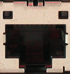
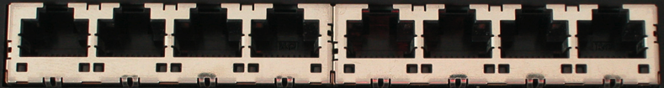
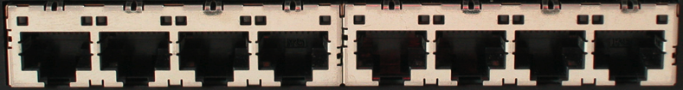
How does OpenFlow work?
Ethernet Switch

Slide 54
OpenFlow Controller
OpenFlow Protocol (SSL/TCP)
OpenFlow Agent
Data Plane (Hardware)

Slide 55
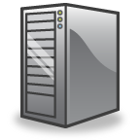

Main components of an OpenFlow switch
OpenFlow Agent
Software
Layer
OpenFlow protocol
Flow Table
Flow Table
…
pipeline
Hardware
Layer
Group Table
Meter Table
Controller
port 1
port 2
port 3
port 4
5.6.7.8
1.2.3.4

Slide 56
Flow Table Entries
Main components of a flow entry in a flow table.
Match fields | To match against packets. These consist of the ingress port and packet headers
Priority | Matching precedence of the flow entry
Counters | e.g. packet and byte counters
Instructions | Determine action set or pipeline processing
Timeouts | Maximum amount of time or idle time before flow is expired by the switch
Cookies | Opaque data value chosen by the controller. Not used when processing packets.
Switch
Port
VLAN
ID
VLAN
pcp
MAC
src
MAC
dst
Eth
type
IP
Src
IP
Dst
IP
ToS
IP
Prot
L4
sport
L4
dport
The match field contains either a specific value or a “wildcard”

Slide 57
Match/action examples
Switching
Switch
Port
MAC
src
MAC
dst
Eth
type
VLAN
ID
IP
Src
IP
Dst
IP
Prot
TCP
sport
TCP
dport
Action
*
*
00:1f:..
*
*
*
*
*
*
*
port6
Flow Switching
Switch
Port
MAC
src
MAC
dst
Eth
type
VLAN
ID
IP
Src
IP
Dst
IP
Prot
TCP
sport
TCP
dport
Action
port3
00:20..
00:1f..
0800
vlan1
1.2.3.4
5.6.7.8
4
17264
80
port6
Firewall
Switch
Port
MAC
src
MAC
dst
Eth
type
VLAN
ID
IP
Src
IP
Dst
IP
Prot
TCP
sport
TCP
dport
Action
*
*
*
*
*
*
*
*
*
22
drop

Slide 58
Examples
Routing
Switch
Port
MAC
src
MAC
dst
Eth
type
VLAN
ID
IP
Src
IP
Dst
IP
Prot
TCP
sport
TCP
dport
Action
*
*
*
*
*
*
5.6.7.8
*
*
*
port6
VLAN Switching
Switch
Port
MAC
src
MAC
dst
Eth
type
VLAN
ID
IP
Src
IP
Dst
IP
Prot
TCP
sport
TCP
dport
Action
port6,
port7,
port9
*
*
00:1f..
*
vlan1
*
*
*
*
*

Slide 59
Headers as a protocol-agnostic collection of bits
Ethernet
DA, SA, etc
IP
DA, SA, etc
TCP
DP, SP, etc
Payload
Collection of bits to plumb flows
(of different granularities)
between end points
Header
User-defined flowspace
Payload

Slide 60
“Flowspace”: A way to think about flows defined by match fields
Single flow
All flows from A
All flows between two subnets
IP DA
A
IP SA

Slide 61
Flowspace: Generalization
Single flow
Set of flows
Field 1
Field 2
Field n

Slide 62
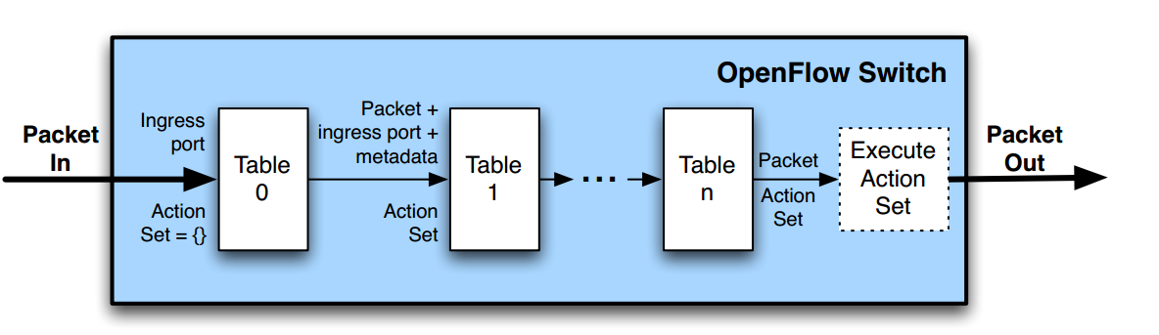
OpenFlow Pipeline
Packets are matched against multiple tables in the pipeline
OpenFlow Switch Specification Version > 1.1.0

Slide 63
Actions
Forward on a port
Flood
Modify packet field
Push/pop tag
Forward to controller
Drop (implicit if no actions)

Slide 64
Table miss
Packets for which no flow has been defined are normally sent to the controller
The controller then defines a new flow for that packet and creates one or more flow table entries
The packet is then processed as determined by the newly created flow entries
By default packets unmatched by flow entries are dropped

Slide 65
OpenFlow key messages
Message | Direction | Description
Packet-In | Switch->Controller | Transfer the control of a packet to the controller. Packet-in events can be configured to buffer packets
Packet-Out | Controller->Switch | Instruct switch to send a packet out of a specified port. Send in response to Packet-in messages.
Modify-State | Controller->Switch | Add, delete and modify flow/group entries in the flow tables and to set switch port properties
Flow-Removed | Switch->Controller | Inform the controller about the removal of a flow entry from a flow table

Slide 66
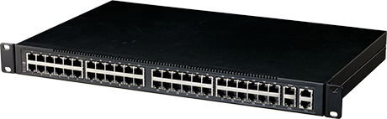


UCL Deployment
Students (Q3 ’14)
IT Cluster (Q3 ’15)
Powered by
Dept. ShadowNet (Q4 ’14)
(Q2 ’15)

Slide 67
Any questions?

